Slide 1
Belmont Wellness Coalition Protecting Your Growing Brain from Nicotine, Alcohol and Marijuana
Maeve Kennelly
Prevention Specialist
Lisa Gibalerio
Public Health Educator
Notes:
Participate in a school, community, or troop program on the dangers of using drugs, alcohol, and tobacco and other practices that could be harmful to your health. Discuss your participation in the program with your family, and explain the dangers of substance addictions. Report to your Scoutmaster or other adult leader in your troop about which parts of the Scout Oath and Scout Law relate to what you learned.

Slide 2
Why We’re Here
We teach kids – and parents – how to make good choices, so they can stay healthy for life.
We talk about substances - so you know the risks and impacts.
We help you to “be prepared”.
Notes:
We teach kids – and parents – how to make good choices, so they can stay healthy for life.
We talk about alcohol - and other drugs - so you know what you’re up against.
We help you “be prepared”.

Slide 3
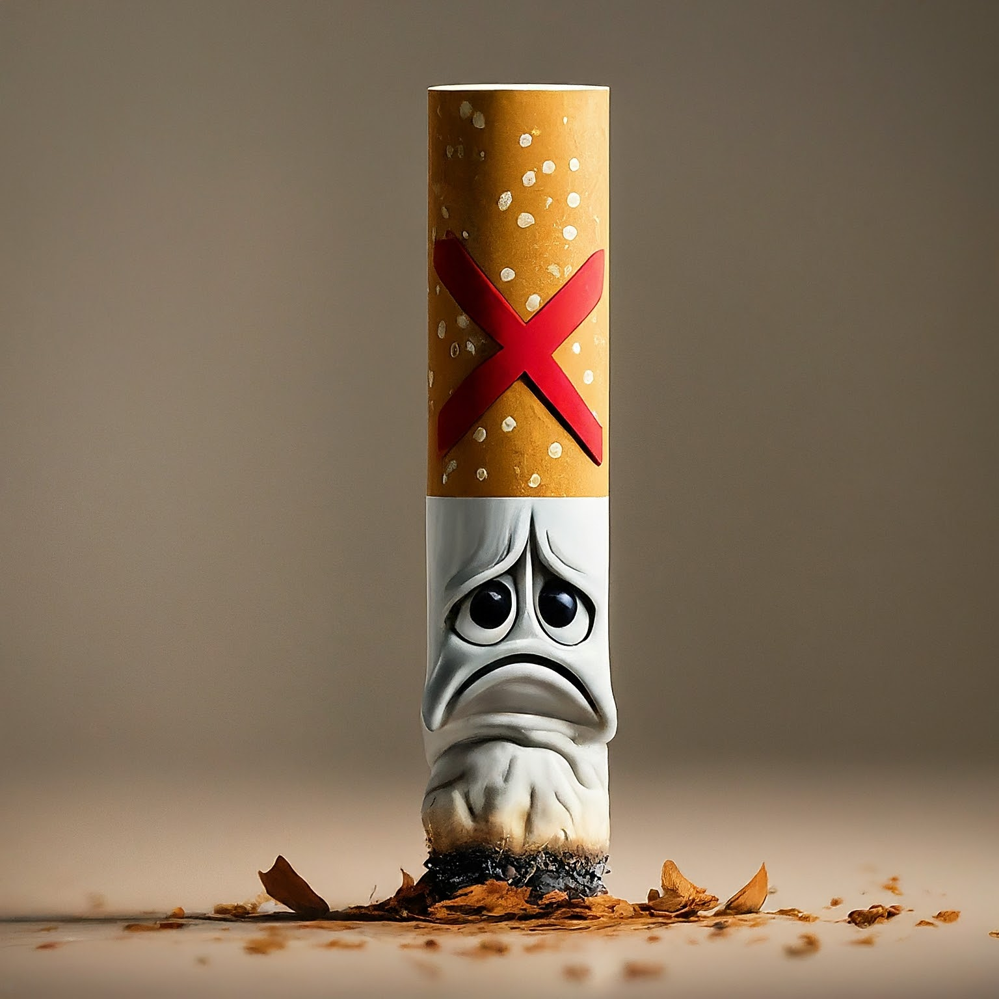
Nicotine
Smoking = Harmful
But why?
Notes:
Before we get to Alcohol and Marijuana, let’s talk about another poison that EVERYONE knows is bad for you: cigarette smoking.
Everyone knows that smoking cigarettes is bad for you – and even for others around people who smoke.
But WHY is it bad? Do you know?...
[get answers]
It’s been well-known for a long time that cigarette smoke causes cancer. It’s loaded with > 400 carcinogens, including nicotine.
Causes lung cancer – which kills [thousands] of people
shortness of breath
bad breath etc.

Slide 4
Smoking
Yet, some people still smoke.
Why might that be?
Notes:
Okay good.
So everyone knows that smoking is bad for you.
But some people still smoke, even today. Why do you think that is?
They don’t know the danger
they don’t have the facts; or
they’re from a different culture
They thought it was cool because that’s how tv and movies and magazines portrayed it for decades
social pressure (peers, or their parents smoked)
Advertising/movies
They’re addicted
Can’t help it, their bodies have adjusted to need it

Slide 5
What did it take for people to stop smoking?
1. Information about harmfulness
2. Treatment for addiction
3. “Truth Campaign” - showing that the tobacco companies were lying (for profit)
Notes:
So how did we get people to quit smoking?
1) Education – provide information on the dangers
But that didn’t necessarily work, especially if addicted
2) Treatment – Addiction recovery programs, medical help
But the real thing that helped was when people realized that they were being tricked!
3) Truth Campaign – nobody likes knowing they were misled, lied to.

Slide 6
Notes:
It’s not just alcohol and marijuana, there are many “poisons” out there.
Best thing is to:
Learn about them
Avoid them as long as possible to protect your growing brain and body

Slide 7
Question:
So, what about alcohol and marijuana?
How are they harmful?
Notes:
So that’s smoking tobacco. It’s one of the poisons people know are bad for you.
And people are smoking a lot less now than they used to.
But what alcohol and marijuana.
They’re both legal. People use them, You see them in movies and online.
Are they bad for you?
Okay, why?

Slide 8
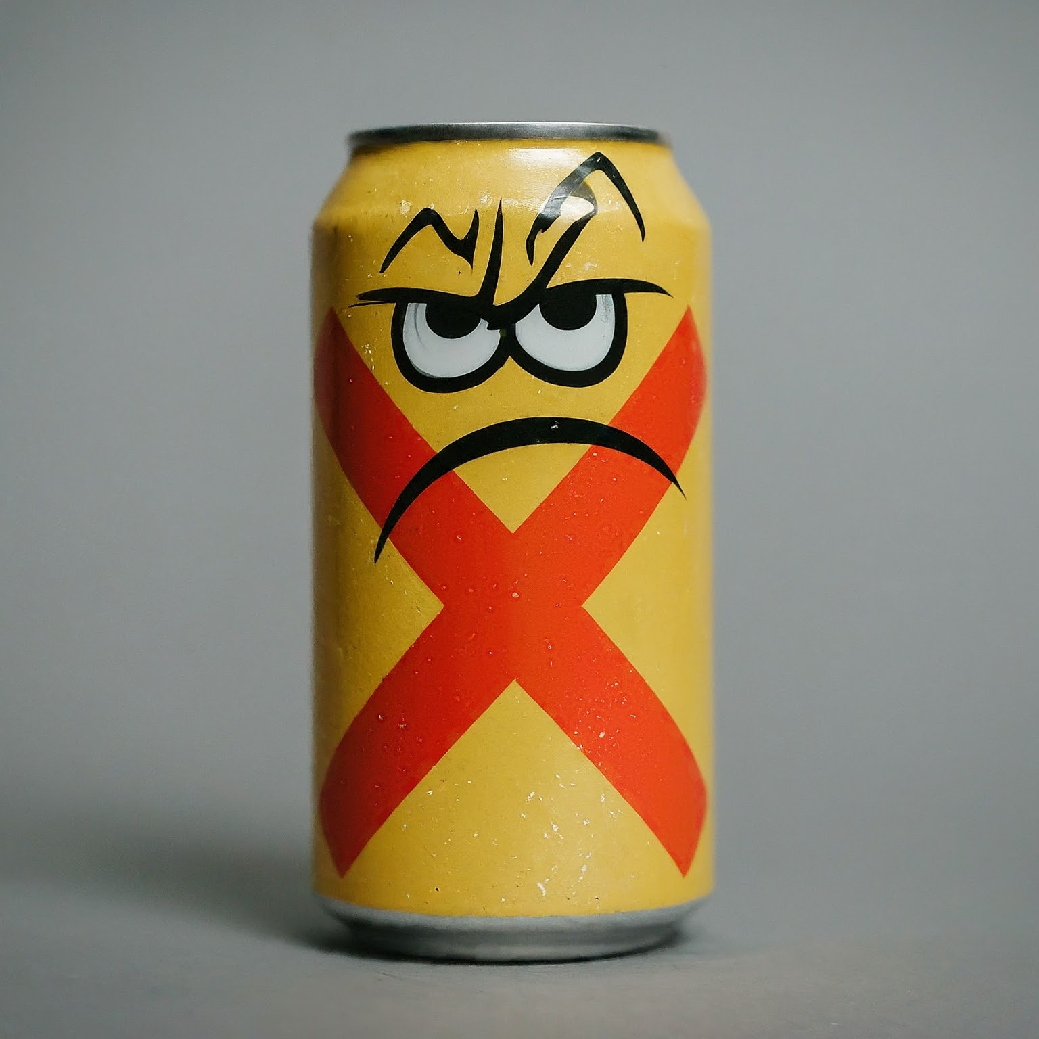
Alcohol:
Let’s discuss alcohol first.
What are the dangers?
Notes:
So that’s smoking tobacco. It’s one of the poisons people know are bad for you.
And people are smoking a lot less now than they used to.
But what alcohol and marijuana.
They’re both legal. People use them, You see them in movies and online.
Are they bad for you?
Okay, why?
[make a list from the responses]

Slide 9
Harmful Impacts of Alcohol Use:
Physical impacts (liver disease)
Emotional effects (depression)
Accidents (driving, drowning, etc.)
Poor decisions (bad judgment, regrets)
Addiction (alcoholism)
Impairs your developing brain
Notes:
To summarize, some of the harms of this poison include:
Increases chance of lethal accidents (car crashes, drownings, other toxins)
Increases chance of making bad decisions (fights, misunderstandings, bad relationship choices, assaults)
Using a lot can trigger addiction
Impacts your developing brain!
The last point is especially important.
In addition to all the other possible impacts, you, as a young person, are still developing.
Your brain in particular still grows until you’re in your mid-twenties.
Alcohol can damage your brain’s development, perhaps permanently, before you’re done growing.

Slide 10
Young brains are vulnerable - why is that?
Notes:
How does alcohol use impair brain function, and brain development in people under 25…?

Slide 11
Your brain:
Will not be done growing for another 15 years!
Chemicals from substances are harmful to brain cells.
The pathways in the brain are susceptible to rewiring – in ways that are not healthy (more on addiction later)

Slide 12
Alcohol and Accidents
Fortunately, younger generations now know not to “drink and drive”
Losing the ability to make good decisions can lead to regrets and bad consequences
Notes:
(SKIP THIS AS A SLIDE?)

Slide 13
What is addiction?

Slide 14
Addiction
Your brain chemistry changes.
Your body will crave more, even if you don’t want it.
It becomes very difficult to stop taking.

Slide 15
What about marijuana?

Slide 16
Marijuana (weed, pot, cannabis)
Another substance to avoid.
Why?
Wasn’t it just made legal - doesn’t that mean it’s fine?
Notes:
If alcohol was poison, then is marijuana venom?
Whatever, it’s another substance you should avoid, and for similar reasons.

Slide 17
Marijuana’s harmful impacts:
Impacts your developing brain
Using weed can lead to laziness
Today’s weed is MUCH stronger = stronger effects
Impacts timing, movement, coordination

Slide 18
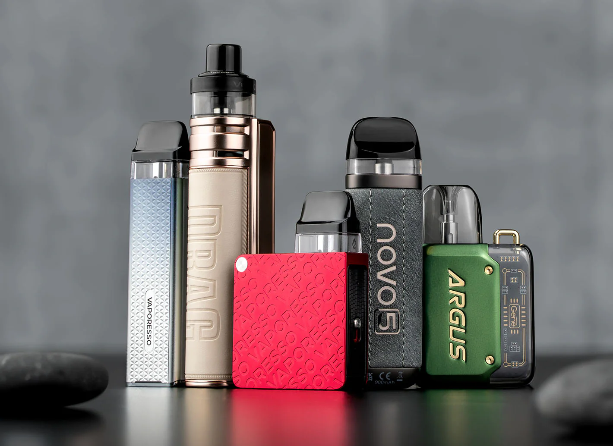
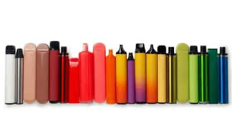

Slide 19
What is Vaping?
Another way to use to use nicotine and/or marijuana.
Removes some of the smoke, and still - the vaporizing is dangerous.

Slide 20
Staying Safe / Good Decision Making:
What are some ways to stay safe?

Slide 21
How to Stay Safe:
Talk with parents (or others you trust)
Having a supportive friend group
Keep busy and engaged
Develop good refusal skills…
Keep an eye on your stress levels

Slide 23
Coping Skills:
What do we mean by “coping skills”?
Can you name some?

Slide 24
Music
Listen to a podcast/streamer
Get outside
Hang with friends
Stay active!
Watch a funny movie
Rearrange your space
Drawing/Journaling

Slide 25
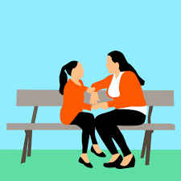
Adults you trust:
Who can you talk with?
Why is this important?

Slide 26
Trusted Adults can be ….
Parents Aunts / Uncles
Neighbors Coaches
Teachers Grandparents

Slide 27
Things to keep in mind:
That substances have chemicals, and those chemicals impact and impair you.
Being “under the influence” puts you at risk.
Look after your friends.
Notes:
Question slide before

Slide 28
To Review:
Take care of your growing brain/body
Saying “No” is the right thing to do
Never pressure someone when they say no
Coping skills are helpful

Slide 29
Questions?

